Slide 1
Accounts Receivable Operations and Reporting in Oracle ERP
Customer Invoices and Billing

Slide 2
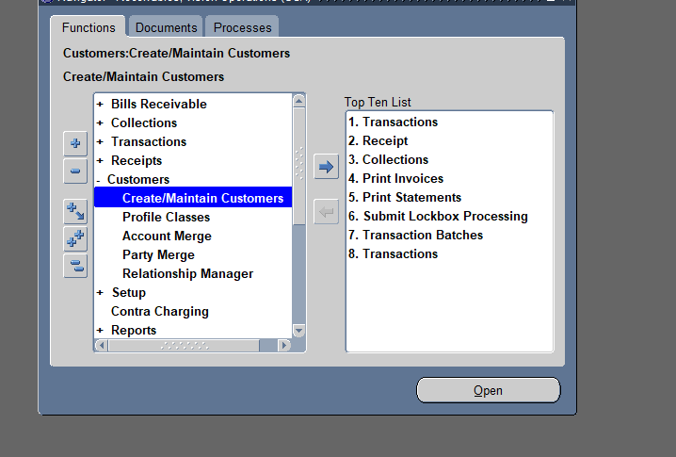
Create and Manage Customer Invoices:
Learn how to create manual customer invoices.
Review invoice details such as customer information, payment terms, and line items.

Slide 3
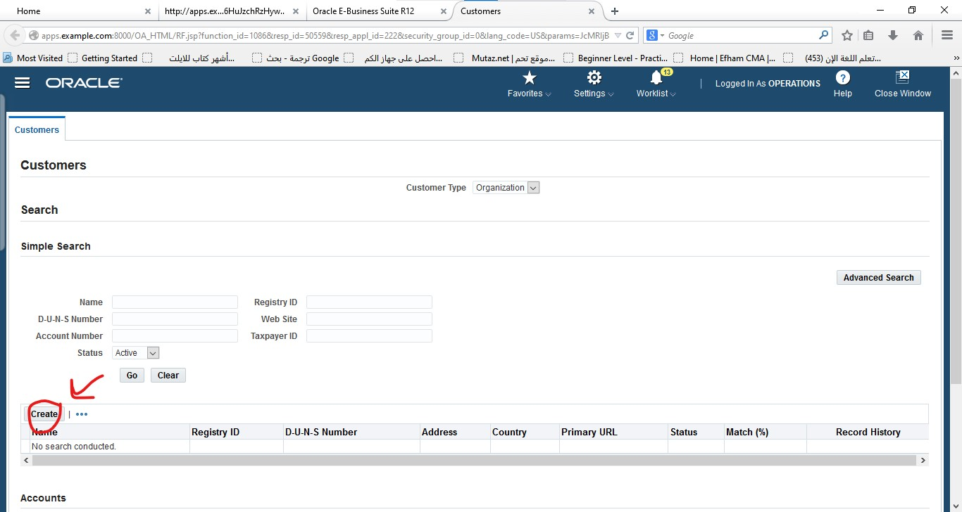
Create customers

Slide 4
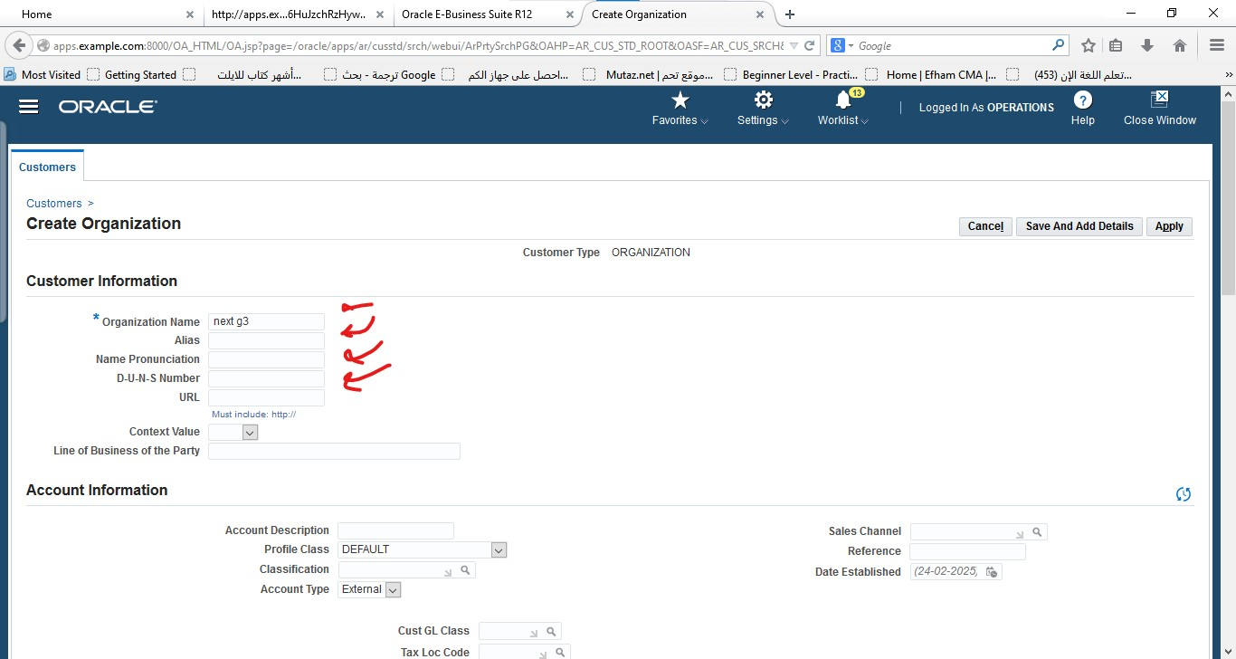
Fill the informations

Slide 5
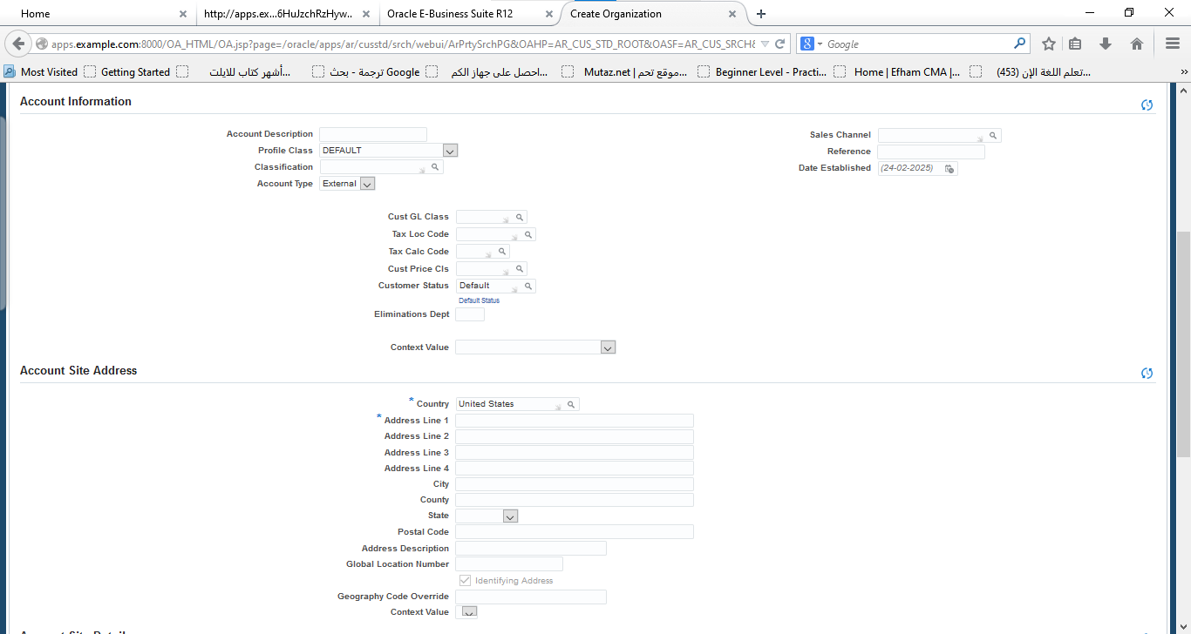

Slide 6
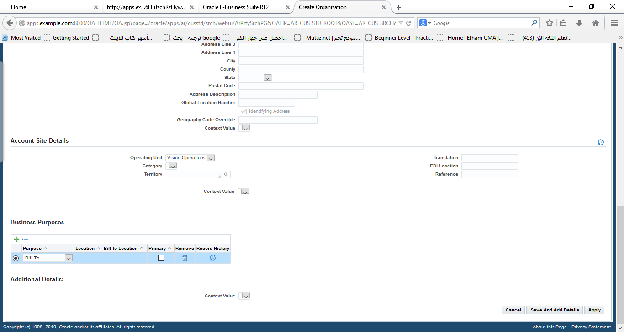

Slide 7
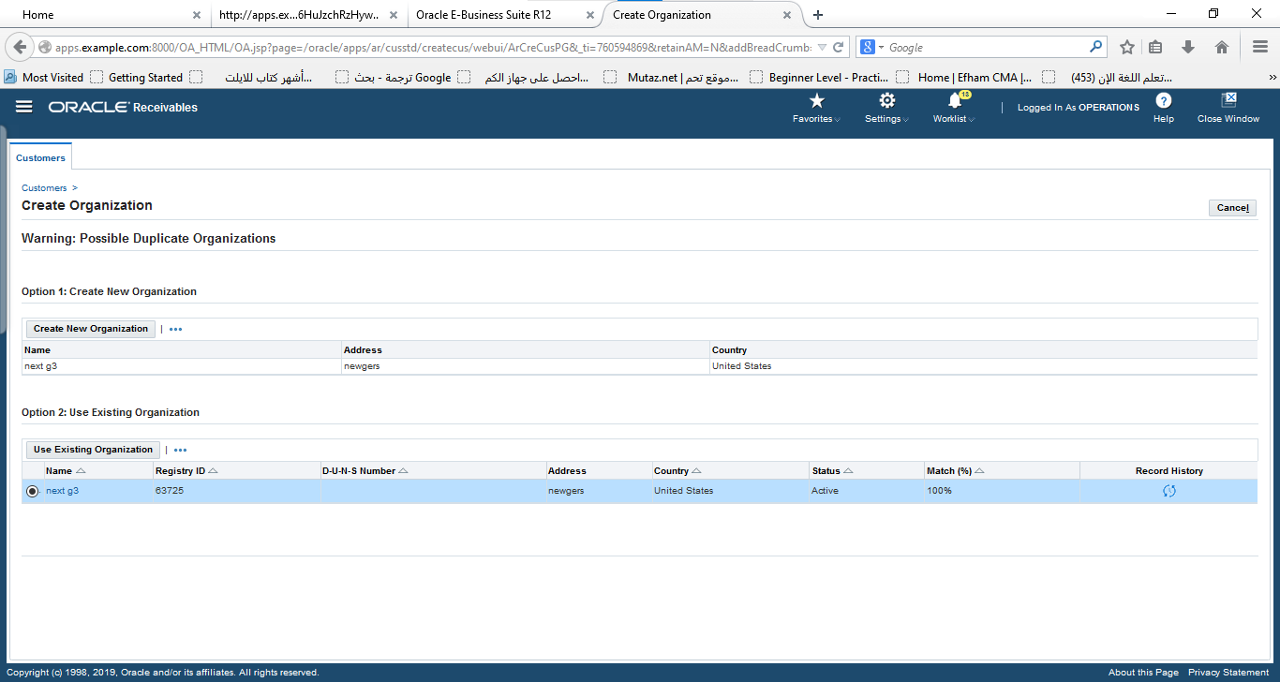

Slide 8
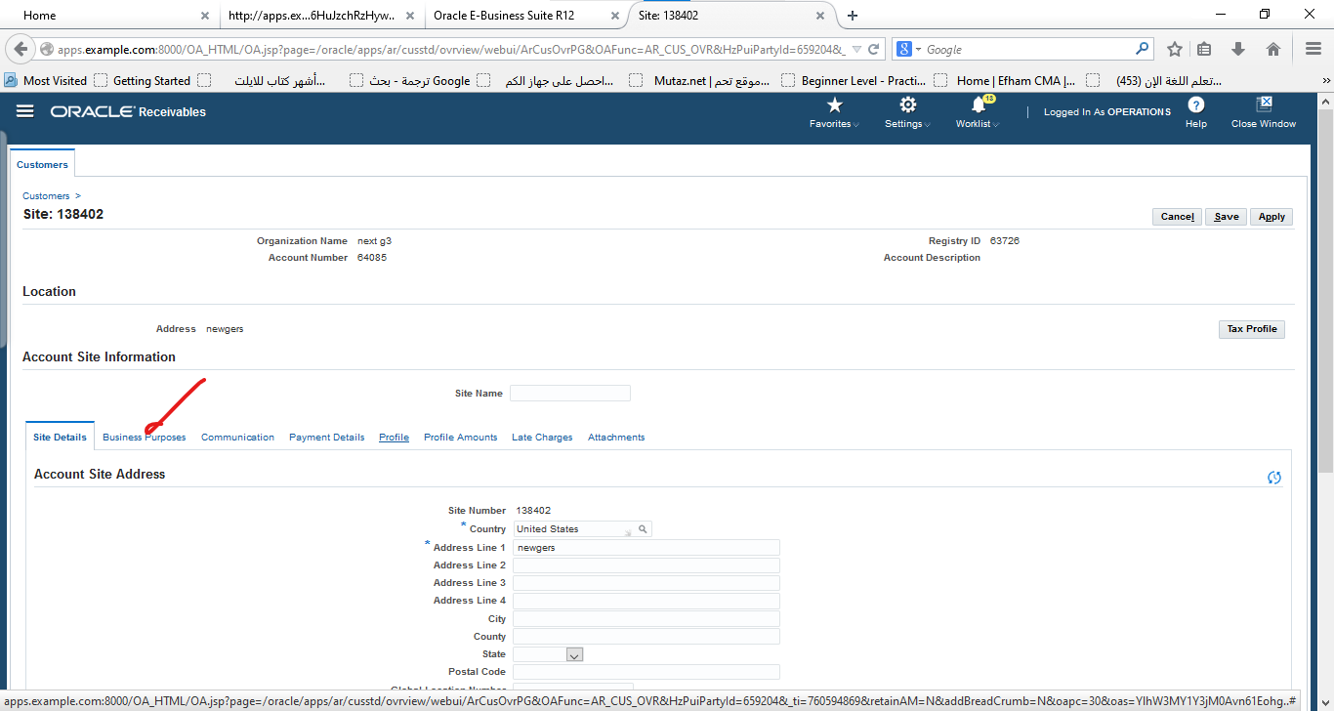

Slide 9
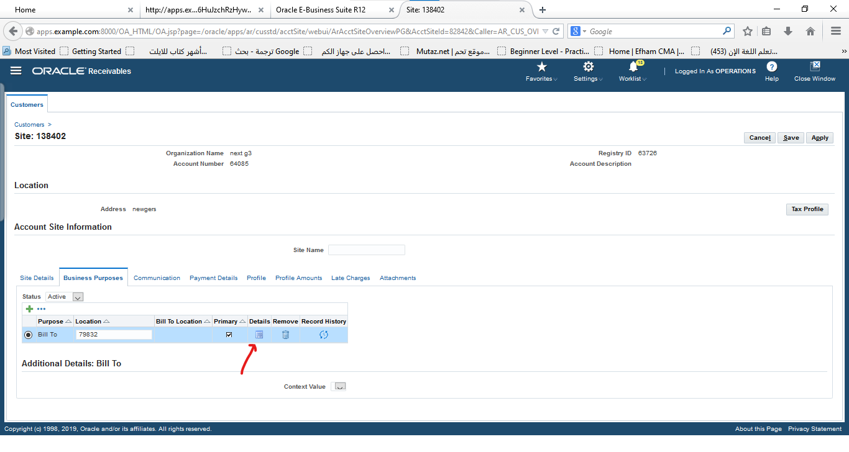

Slide 10
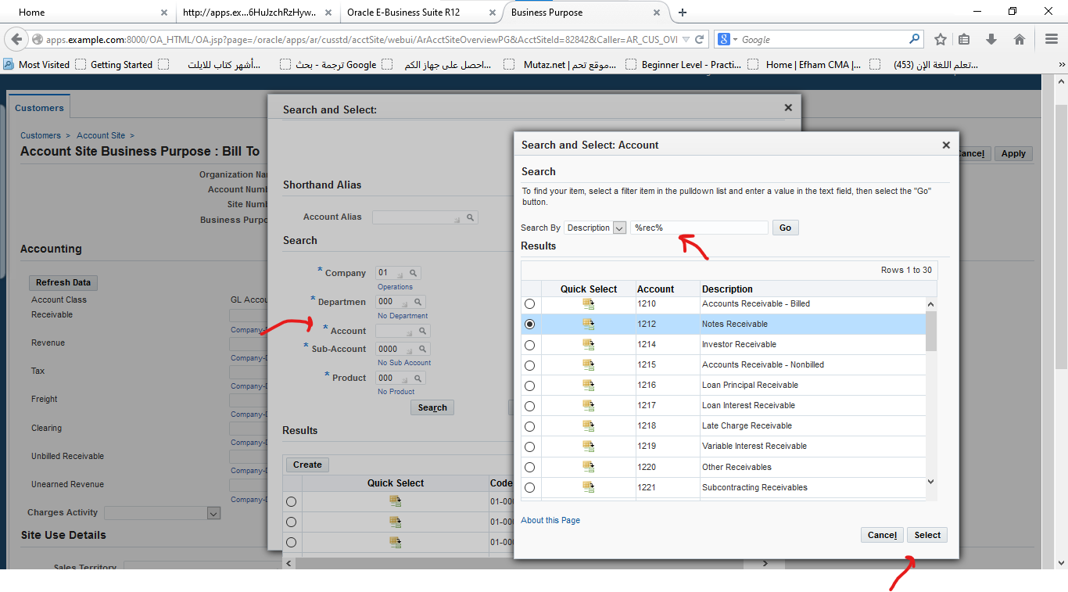

Slide 11
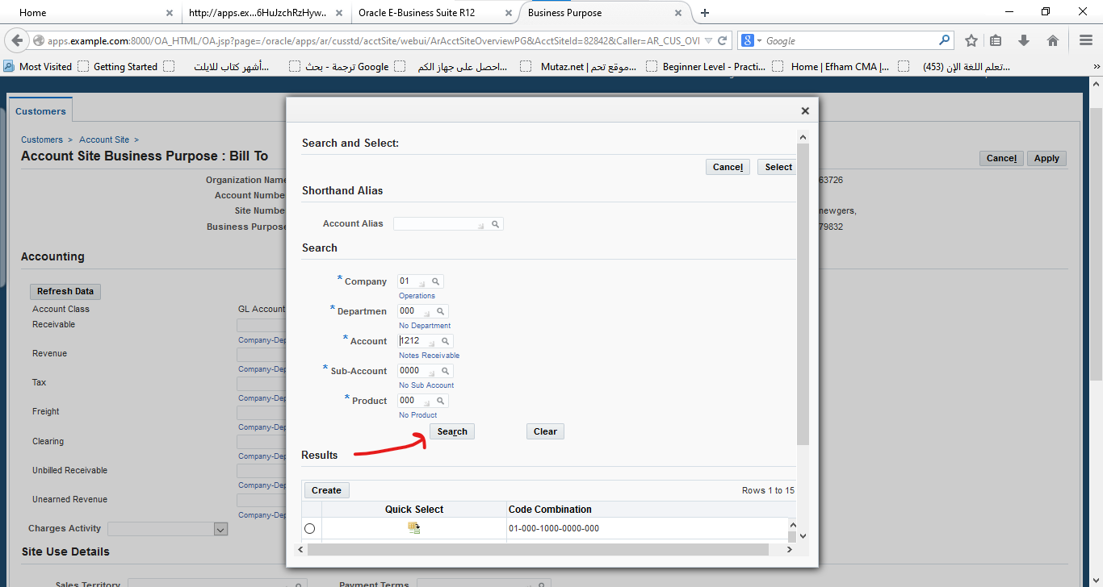

Slide 12
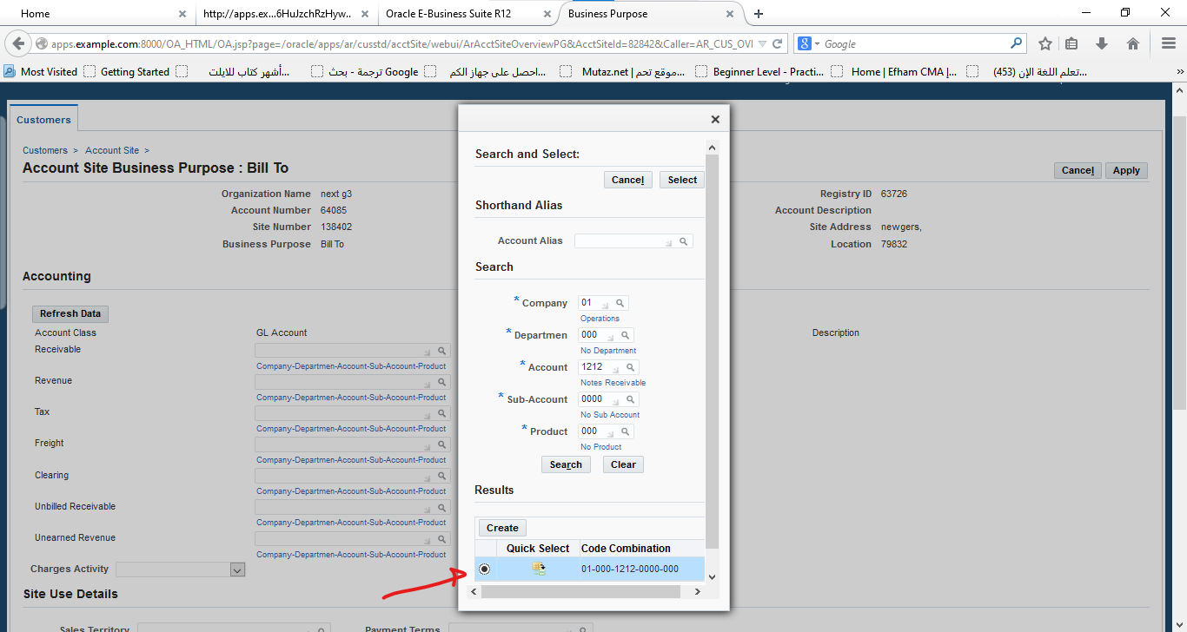

Slide 13
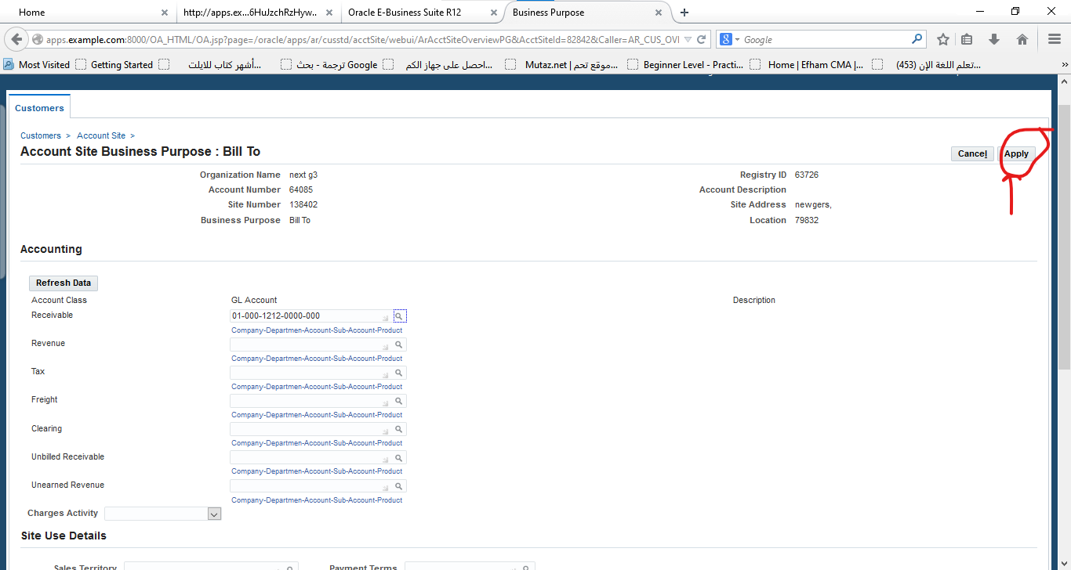

Slide 14
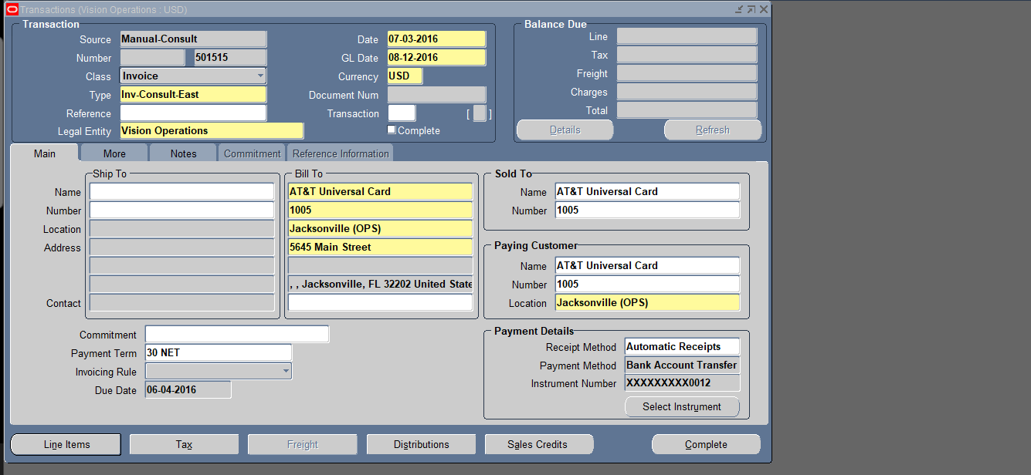
Enter Invoice Header Details

Slide 15
Transaction Type: Choose the invoice type (e.g., Standard Invoice, Credit Memo).
Customer Name: Select the customer from the list.
Bill-to and Ship-to Addresses: Ensure the correct addresses are populated.
Payment Terms: Select terms like "Net 30", "Net 60", etc.
Transaction Date: Select the date for the invoice.

Slide 16
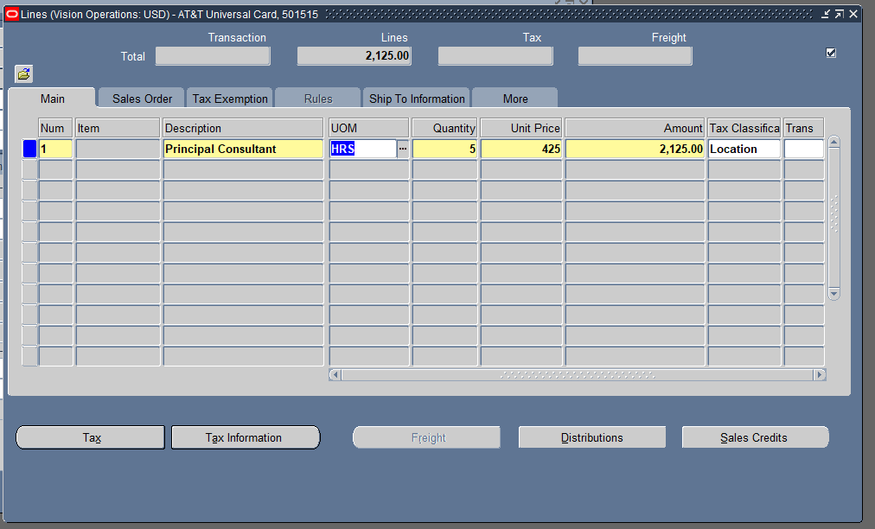

Slide 17
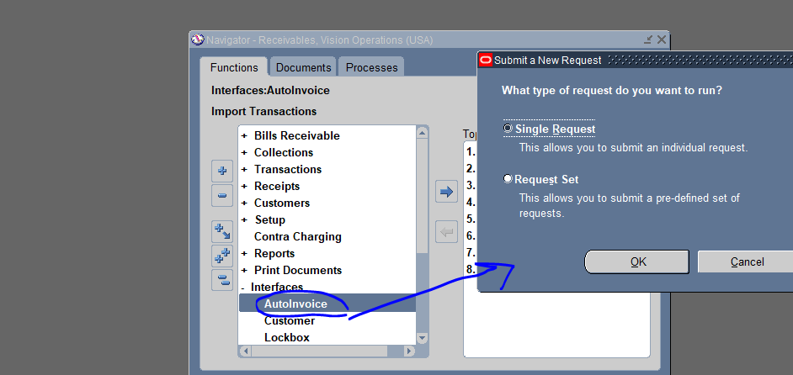
Auto-Invoicing Process: Use the auto-invoice process to import and generate invoices from other modules (e.g., Order Management). Validate and post auto-generated invoices

Slide 18
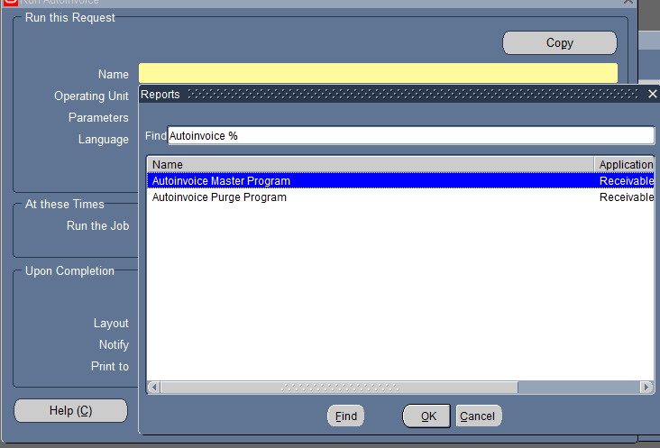

Slide 19
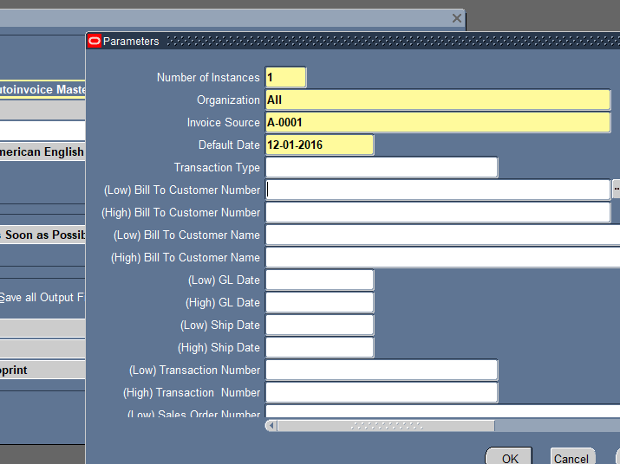

Slide 20
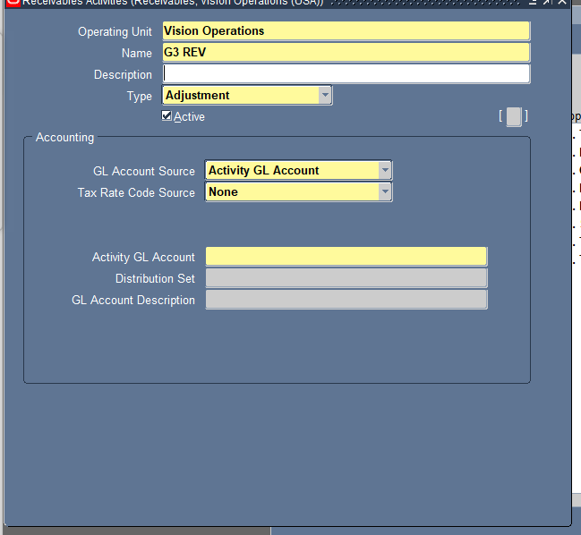
Invoice Adjustments: Apply adjustments or credits to existing customer invoices (e.g., discounts, disputes). Post adjustments and analyze their impact on the customer's account balance.

Slide 21
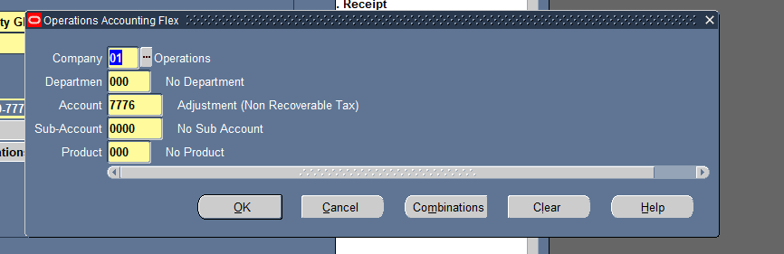

Slide 22
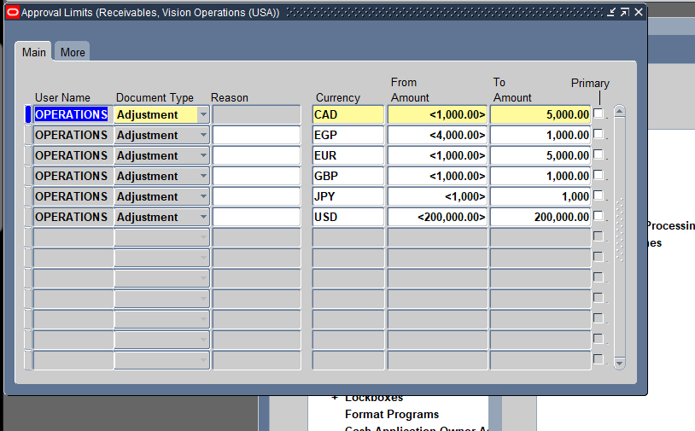

Slide 23
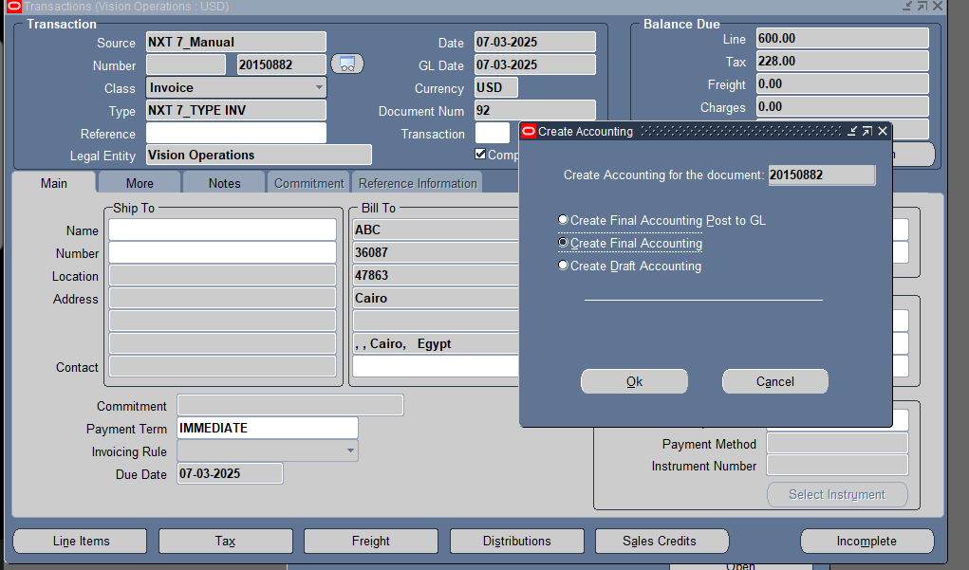

Slide 24
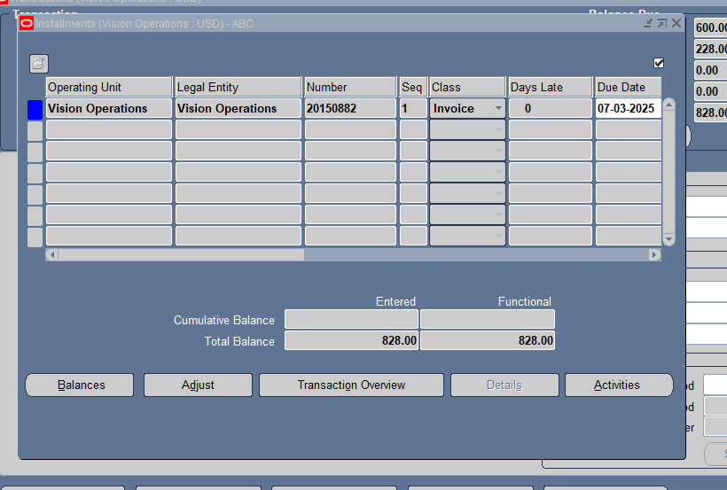

Slide 25
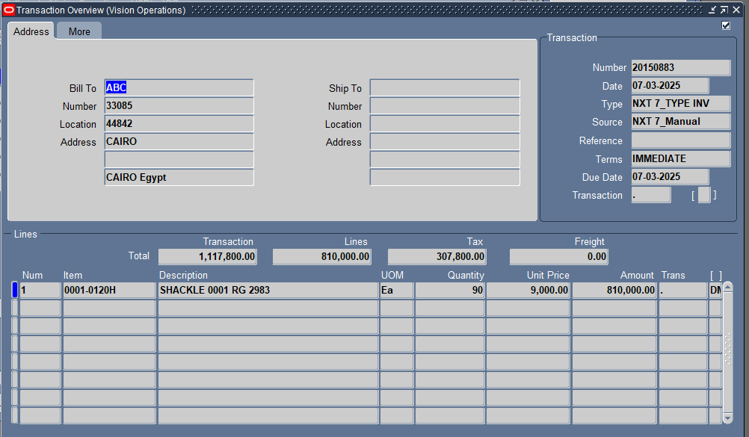

Slide 26
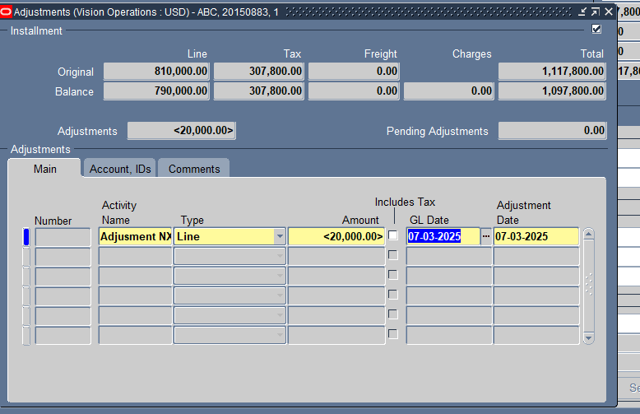

Slide 27
Post the Adjustment to the General Ledger
Navigate to Receivables > Receipts > Create Accounting.
Select Process Category: Adjustments.
Click Submit to post the adjustments.
Step 2: Analyze the Impact on the Customer's Account
Check the Customer Account Balance:
Navigate to Receivables > Accounts > Customer Balances.
Review the updated balance after the adjustment.
Run AR Adjustment Reports:
Go to Receivables > Reports and Analytics.
Run the Adjustment Register Report to track all modifications.
Run the Customer Balance Report to verify the impact on the customer's outstanding amount.

Slide 28
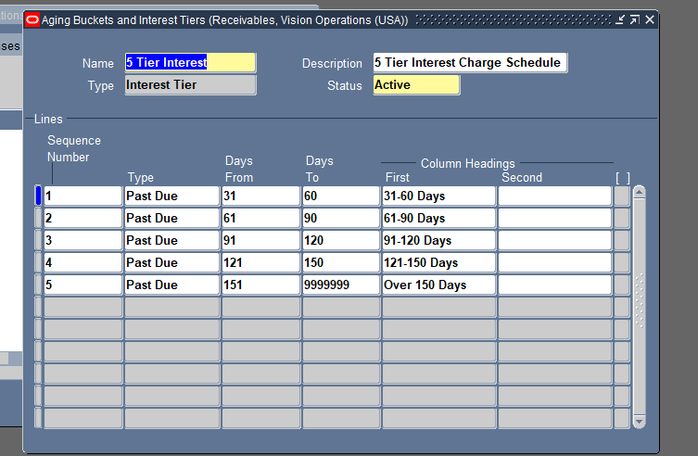
Customer Inquiry and Aging Report: Use inquiry tools to view customer account details. Run and review the Aging Report to track outstanding balances by customer

Slide 29
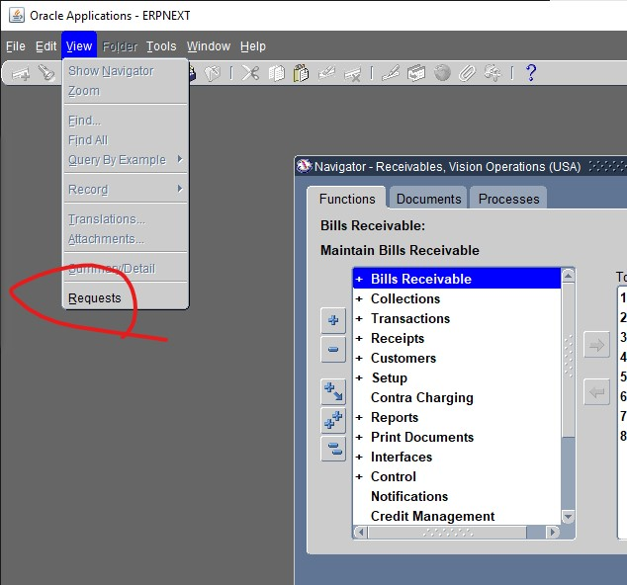

Slide 30
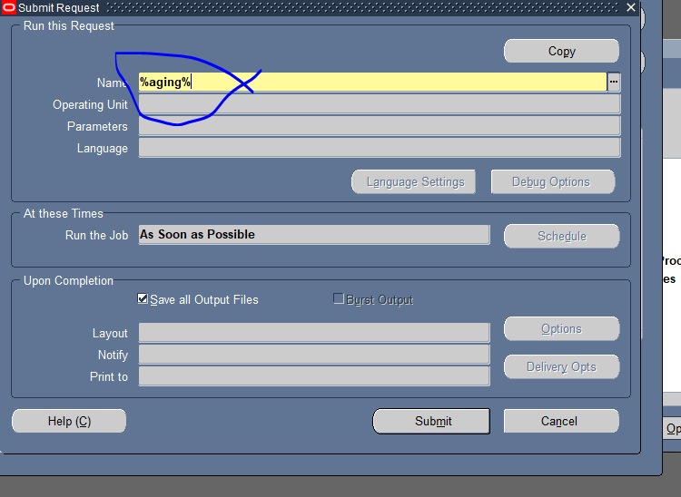

Slide 31
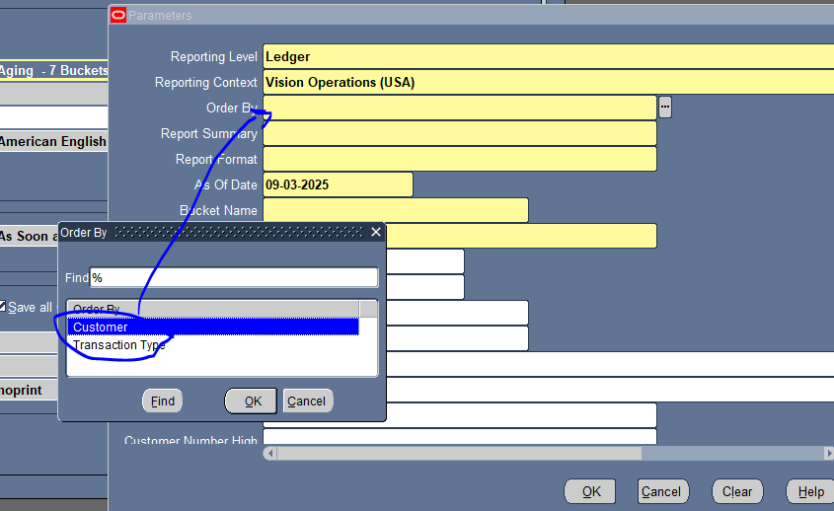

Slide 32
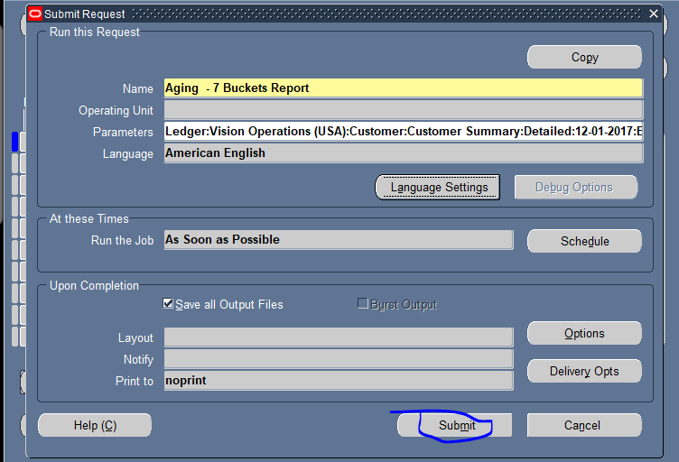

Slide 33
The Aging Report is essential for tracking outstanding balances and overdue invoices by customer and aging periods (e.g., Current, 30 days, 60 days, 90 days). The process includes:
Running the Aging Report
Navigate to Receivables > Reports > Aging Reports.
Select report parameters such as date range, customer category, and currency.
Choose the Aging Buckets (e.g., 0-30, 31-60, 61-90, 91+ days) to categorize overdue balances.
Reviewing the Aging Report
Identify customers with high outstanding balances or overdue invoices.
Analyze aging trends to manage collection efforts and assess financial risks.
Export the report to Excel or PDF for further analysis and sharing.
Taking Action on Aged Receivables
Follow up with customers on overdue balances.
Apply credit holds on accounts with prolonged unpaid invoices.
Initiate collection efforts or payment reminders based on aging status

Slide 34
Payment Management and Cash Applications Alia & Mahmoud

Slide 35
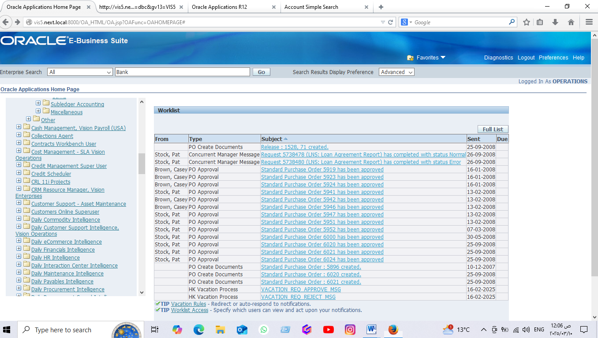
Create bank
From cash management , vision payroll(USA) LIST:

Slide 36
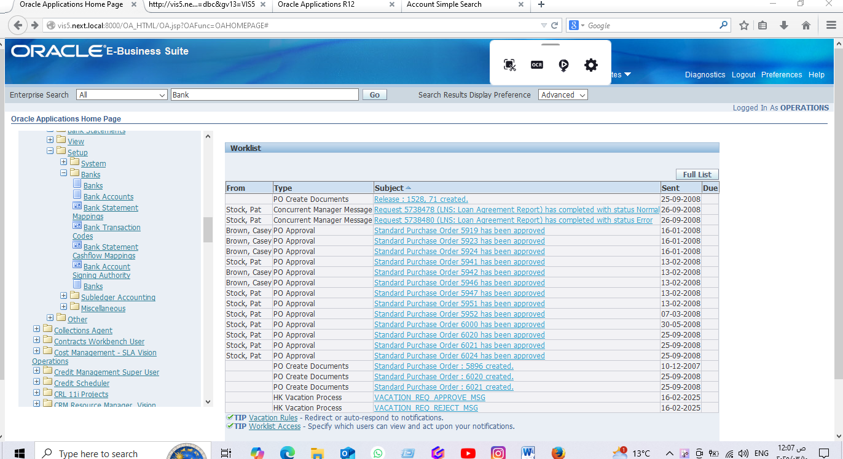
2- Choose set up, then bank then bank account

Slide 37
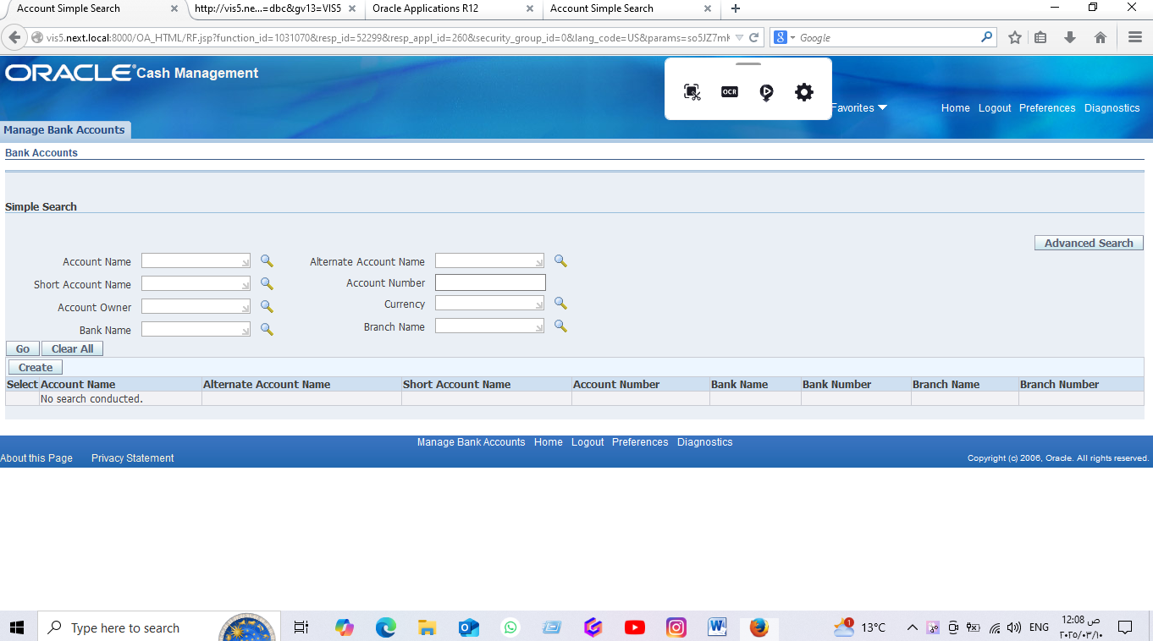
3-select create:

Slide 38
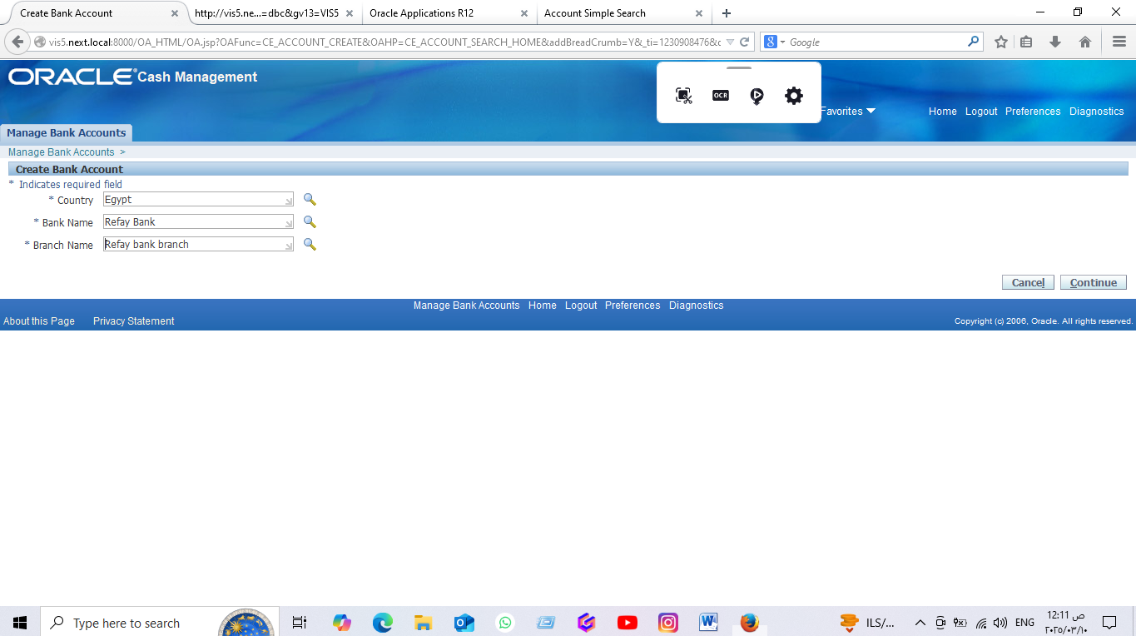
4-create bank account then contenue:

Slide 39
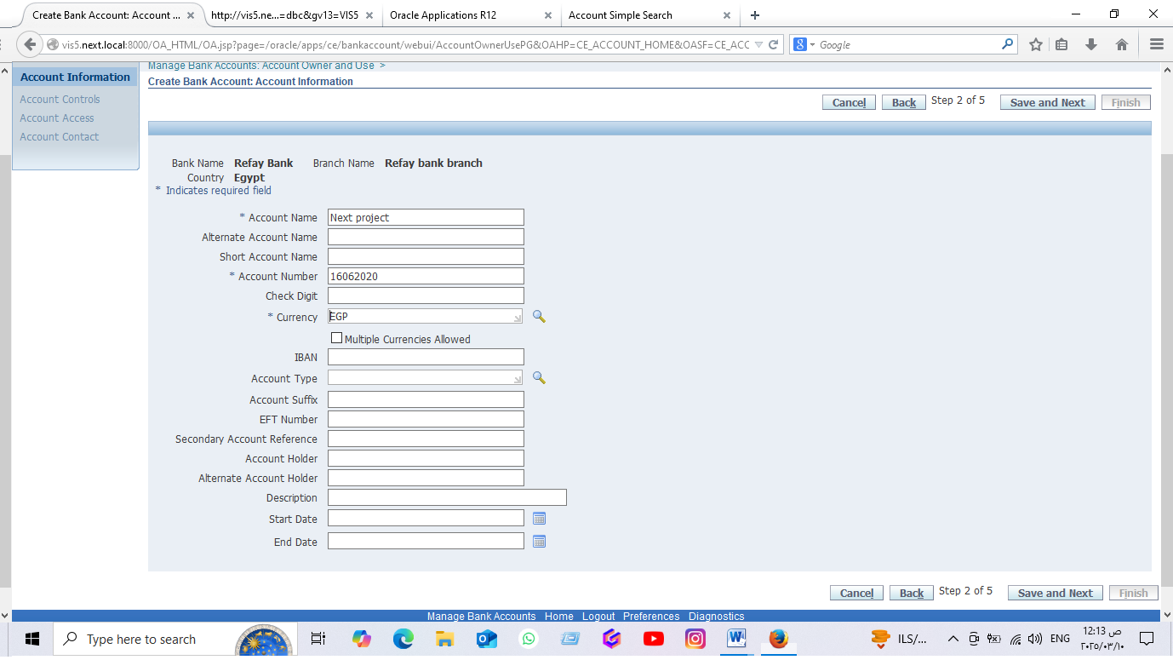
5- Fill the account information, then save and next:

Slide 40
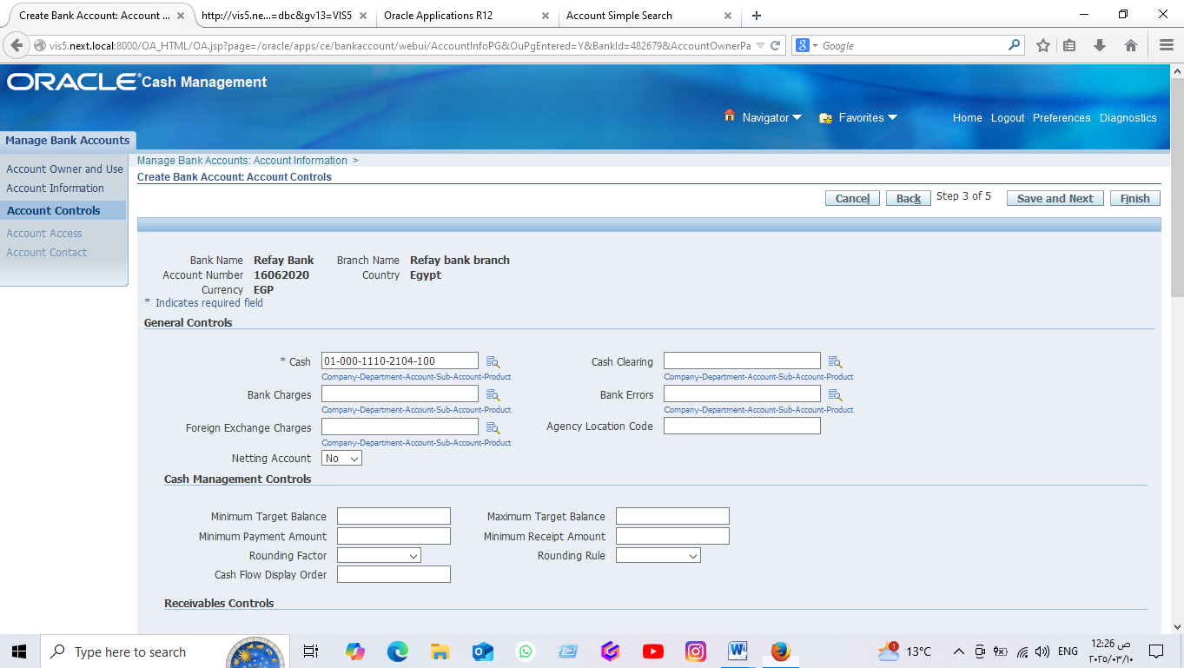
6- Fill account controls, then save and next

Slide 41
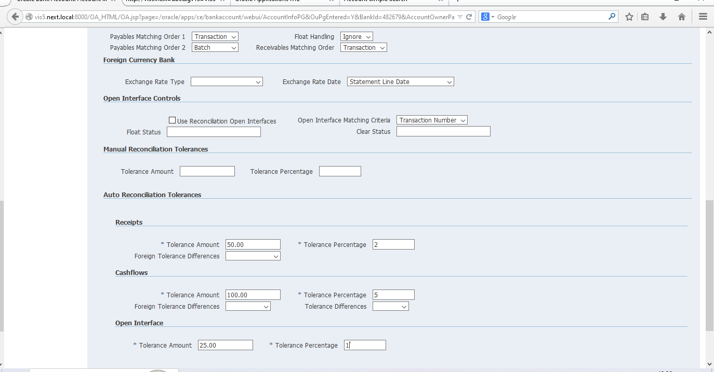

Slide 42
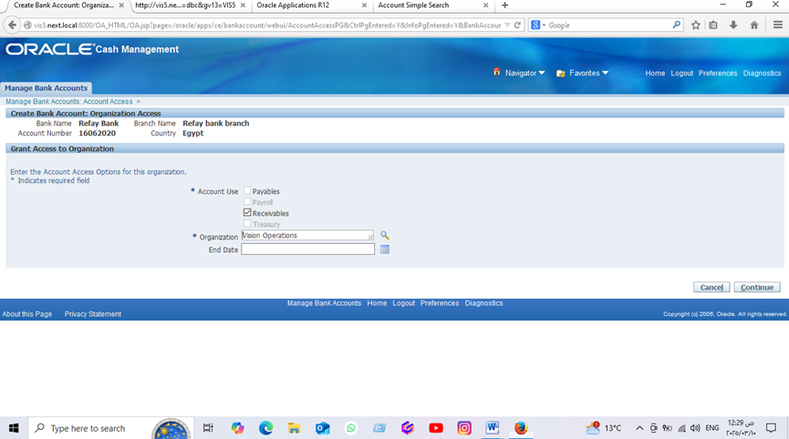
7- Fill account access then contenue

Slide 43
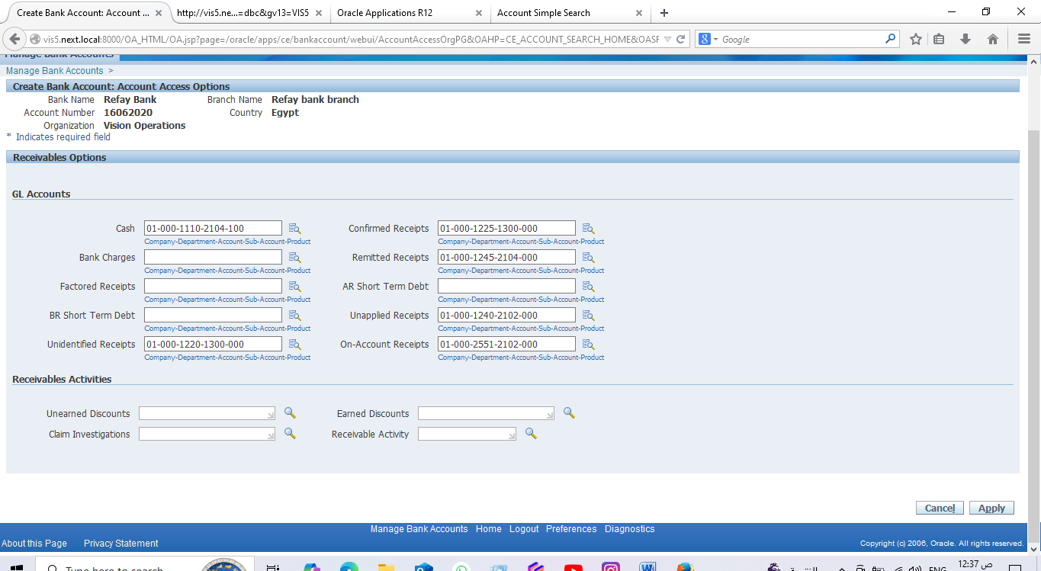
8- Fill account access options , then apply:

Slide 44
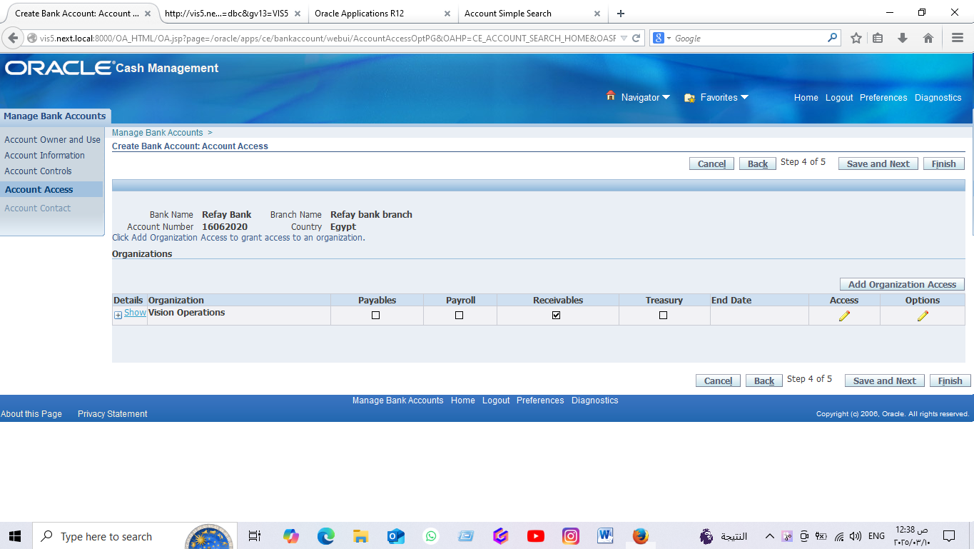
9- select account access, then save and next

Slide 45
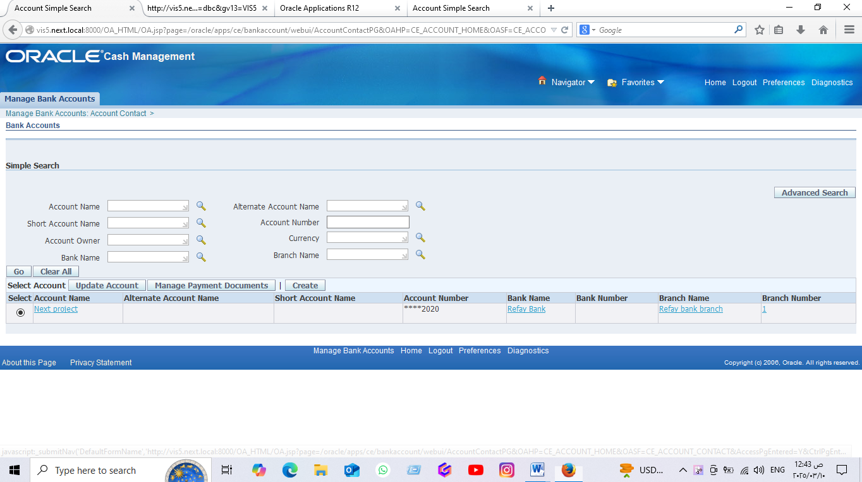
10- Select account contact then finish:

Slide 47
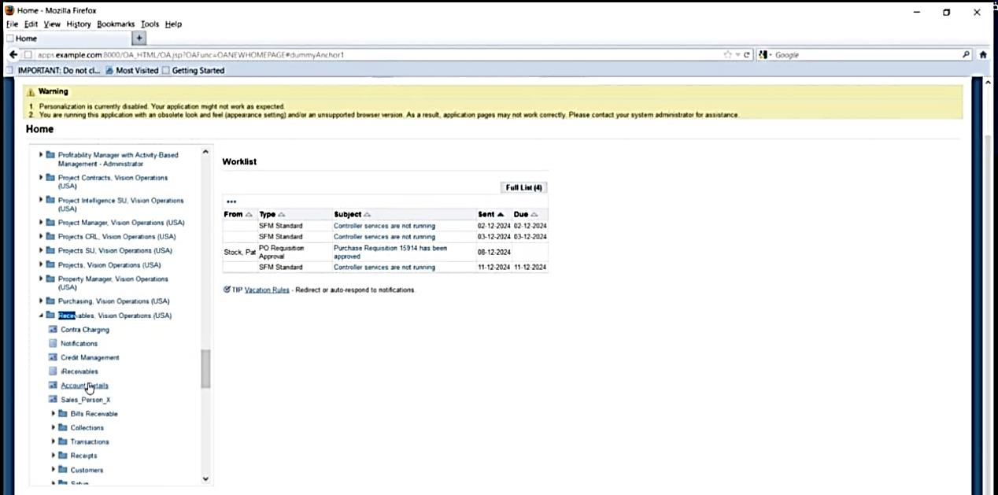
From receivable , vision operations (USA), select Account details

Slide 48
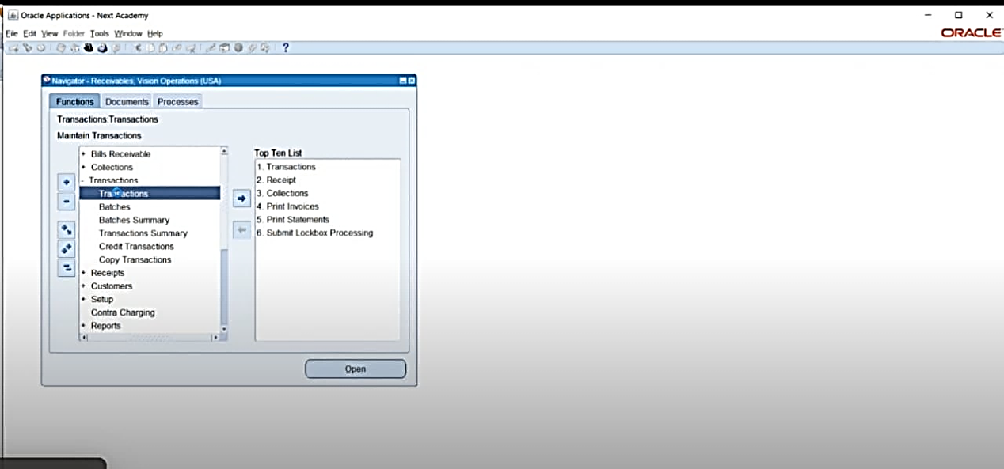
2-From Transaction, select transaction:

Slide 49
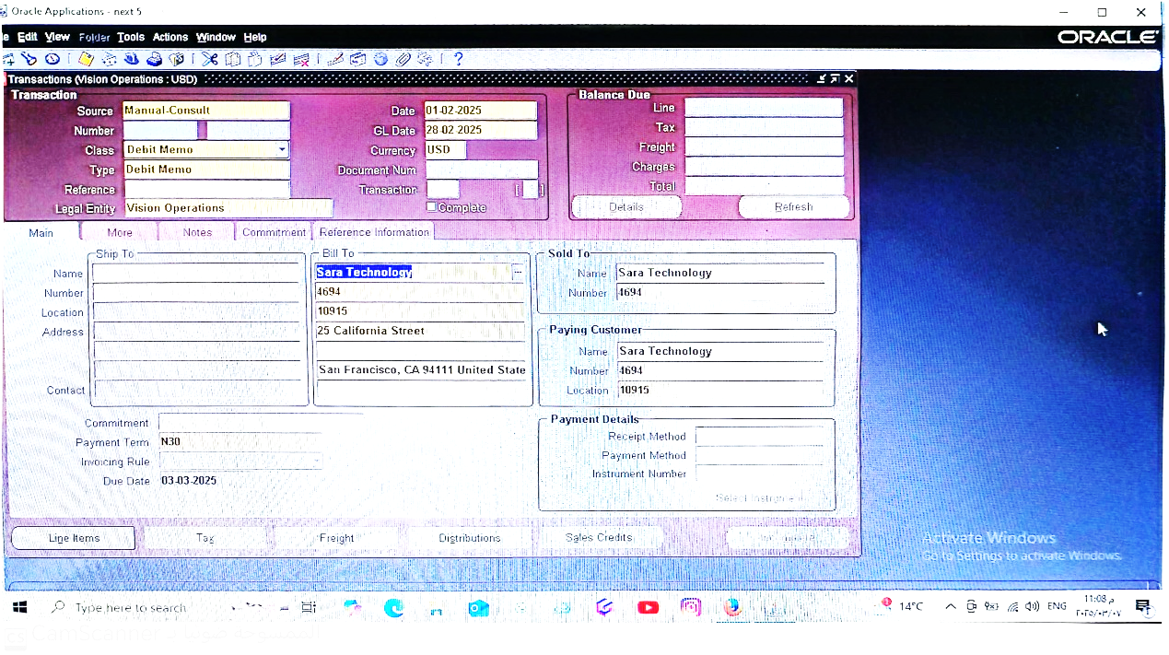
3- Fill transactions, then select line items:

Slide 50
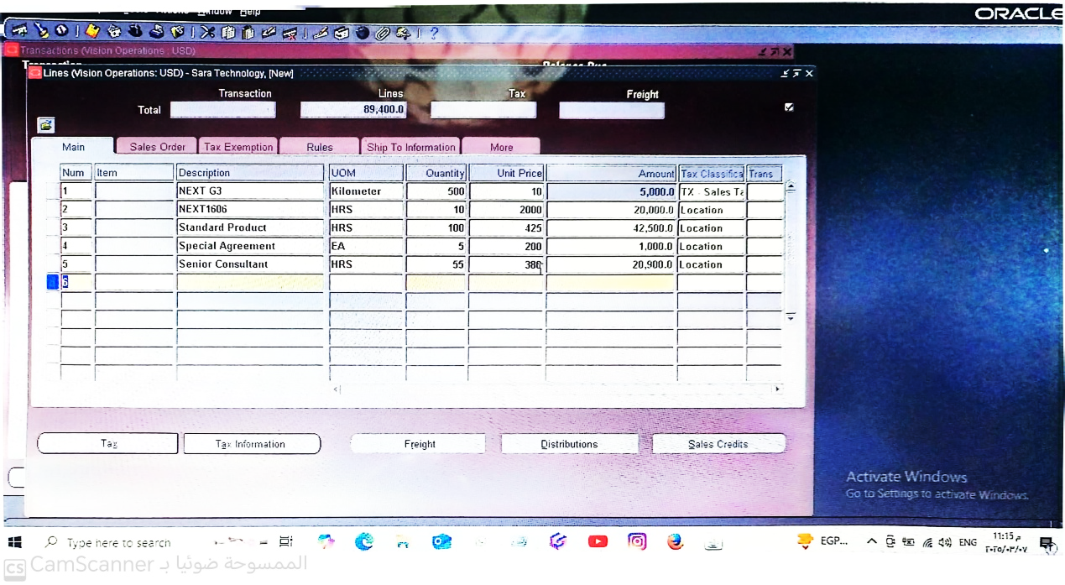
4- FILL LINES, THEN SELECT SAVE, THEN COMPLETE:

Slide 51
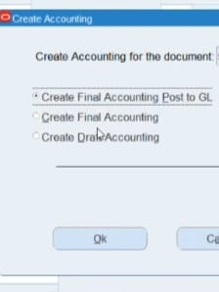
5-From tools select create accounts, and then select create final accounting, then OK:

Slide 52
credit memo

Slide 53
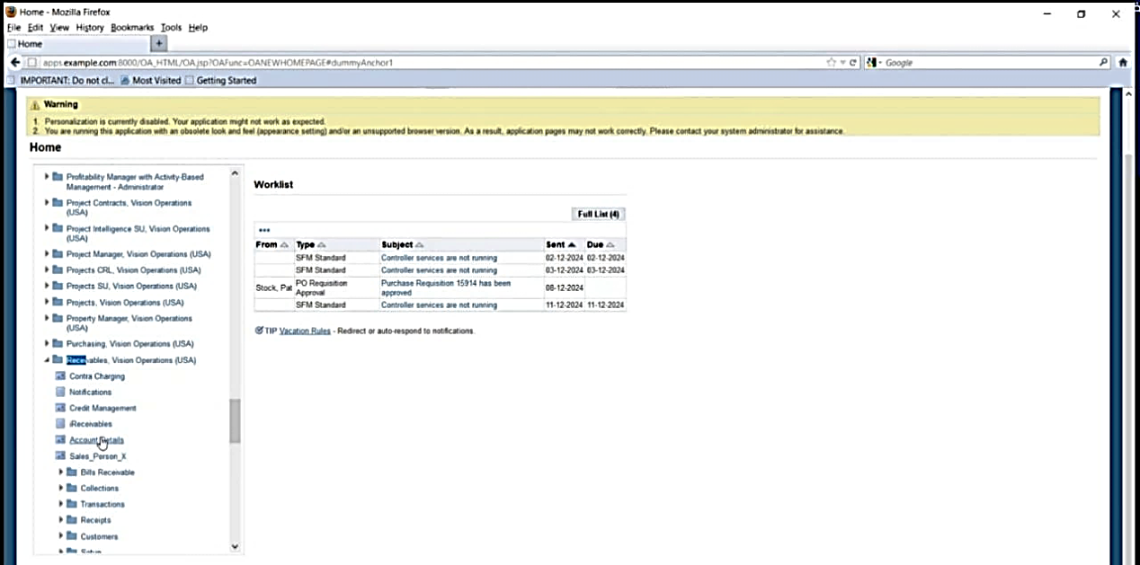
From receivable , vision operations (USA), select Account details:

Slide 54
2-From Transaction, select transaction:

Slide 55
3- Fill transactions, then select line items

Slide 56
4- Fill lInes, then select save, then complete:

Slide 57
5-From tools select create accounts, and then select create final accounting, then OK:

Slide 58
INVOICE

Slide 59
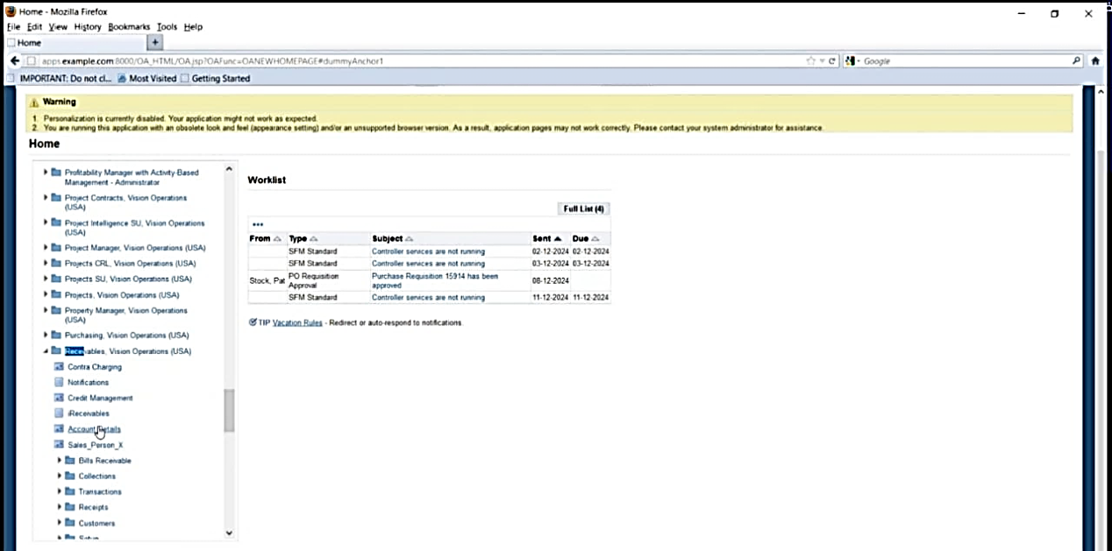
1-From receivable, vision operations (USA), select Account details:

Slide 60
2-From Transaction, select transaction:

Slide 61
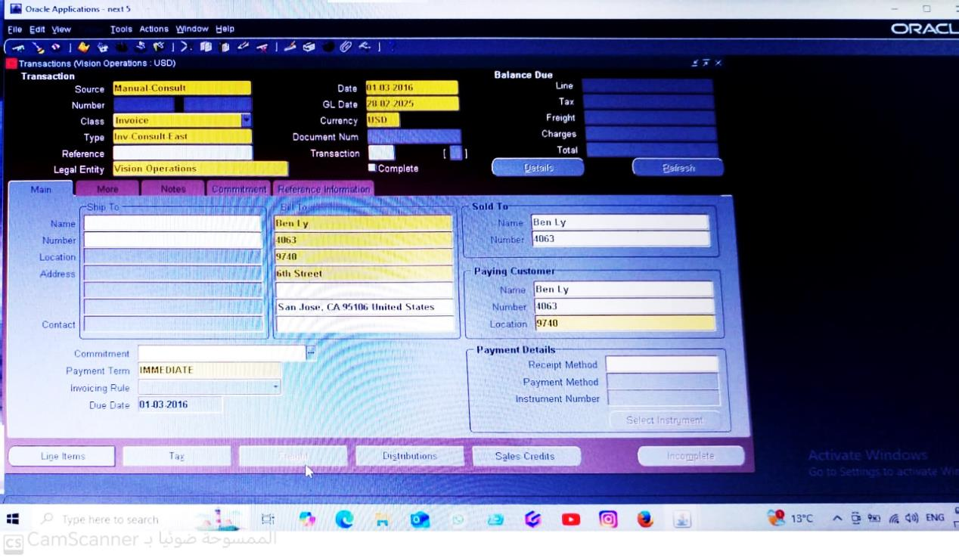
3- Fill transactions, then select line items:

Slide 62
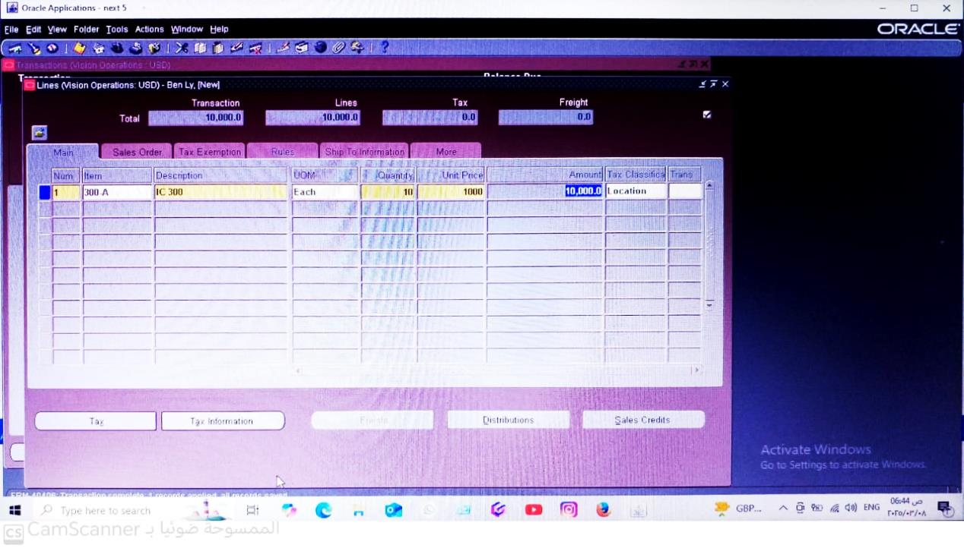
4- Fill lInes, then select save,then complete:

Slide 63
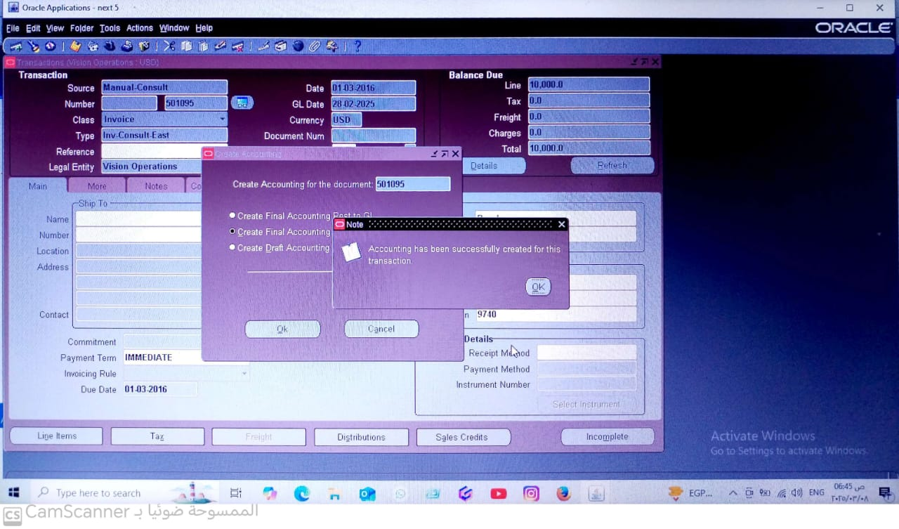
5-From tools select create accounts, and then select create final accounting, then OK:

Slide 64
Source

Slide 65
1- From receivable, vision operations (USA), select SET UP, THEN SOURCE:

Slide 66


Slide 67

2- Fill source then close:

Slide 68
Receipt class

Slide 69

1- From receivable, vision operations (USA), select SET UP, And THEN Receipt classes:

Slide 70

2- Fill it, and then select bank accounts, then select save:

Slide 71


Slide 72
Receipts

Slide 73

1- From receivable, vision operations (USA), and select receipts, And THEN Receipt:

Slide 74

2- Fill receipt class, and then select apply:

Slide 75


Slide 76


Slide 77


Slide 78


Slide 79


Slide 80


Slide 81
Remittance

Slide 82

1- From receivable, vision operations (USA), and select remittance:

Slide 83


Slide 84


Slide 85





Make A Receipt

Slide 86


Apply on Account

Slide 87


Create Accounting

Slide 88


Create final accounting

Slide 89


View accounting
Impact on Entry

Slide 90


Make a Reverse

Slide 91


Create final Accounting
Impact on Entries

Slide 92


Process customer Refund

Slide 93


Apply

Slide 94



Refund transactions in pending

Slide 95
Abdo alfattah& osama
Period Closing and Reporting

Slide 96

AR Period-End Close

Slide 97


Slide 98


Slide 99

Generate Financial Reports

Slide 100

Customer Balance Revaluation Report

Slide 101

عرض نافذة اختيار نوع الطلب الجديد، حيث يمكن اختيار طلب فردي او مجموعة طلبات

Slide 102

Customer Balance Revaluation Report

Slide 103

قائمة بجميع الطلبات التي تم تقديمها في النظام وجميعها في حاله صحيحه

Slide 104

Customer Balance R evaluation Report

Slide 105


Slide 106

Transaction Register"هو تقرير لسجل المعاملات المالي

Slide 108

Write-offs
Process and Post Write-offs for Uncollectible Accounts
1- Navigator setup receivables activities

Slide 109


Slide 110

2. Full the digit of name and description

Slide 111

3. Choose type digit as (receipt write-offs

Slide 112

4. Choose activity GL Account

Slide 113

5. Click ok

Slide 114

6. Full the digit of account as Bad Debits

Slide 115

7. Search for bad debits and select it

Slide 116

8. After select the bad debit account

Slide 117

9. Then click ok to continue

Slide 118

the activity GL account and GL account description changed

Slide 119

Approval Limits
Review the impact of write-offs on the customer account and financial report

Slide 120

Make a document type as receipt write-offs
And look at the ( to amount )
an inverse relationship

Slide 121

Receipts ----- receipts

Slide 122

Choose receipt number and method
Enter the dates (receipt – GL- Maturity)
Enter customer data
Press apply

Slide 123

Choose receipt write-offs from apply to digit

Slide 124

Ensure that date an amount are right

Slide 125

Go to activity digit

Slide 126

Choose your account write-offs account
(ahmed write-offs )

Slide 127

From tool menu choose
Create final accounting

Slide 128

The cash account is depts. With 7000
And write-offs account is credit with 7000

Slide 129

AR Reconciliation
First, open cash management module

Slide 130

From bank statement, choose bank statement and reconciliation

Slide 131

Press new

Slide 132

Fill the data

Slide 133

Bank account
Account number
Make the date at the same period

Slide 134

Press lines

Slide 135


Slide 136

Fill the data
Line. Type . account number
Transaction date…etc

Slide 137


Slide 138


